Slide 1


K.RAMAKRISHNAN COLLEGE OF TECHNOLOGY
(AUTONOMOUS), TRICHY.
DEPARTMENT OF
COMPUTER SCIENCE AND ENGINEERING
20CS5501 DESIGN PROJECT-1
Batch No. : 17
Date : 05.12.2024

Slide 2
TWITTER SENTIMENT ANALYSIS IN DIFFERENT LOCATIONS
Guided by Team
Mrs.K.VALLI PRIYADHARSHINI DENNIS CYRUS J(811722104027)
M.E.(Ph.D) HARRISH RAGHAVENDAAR R R
(811722104051)
JEEVAN T (811722104063)

Slide 3
OBJECTIVE OF THE PROJECT
Understand Public Feelings About Mental Health: Analyze tweets to figure out if people feel positive, negative, or neutral about mental health topics.
Explore Regional Differences: Study tweets from different locations to see how people in various areas think and feel about mental health.

Slide 4
ABSTRACT
This project aims to address this by using sentiment analysis to categorize tweets related to mental health into positive, negative, or neutral sentiments.
The project uses Twitter's API to fetch real-time data, processes the data using machine learning processing tools, and visualizes the results.

Slide 5
LITERATURE SURVEY
TITLE OF THE PAPER | AUTHOR (S) | GIST | MERITS/DEMERITS
A DOMAIN-AGNOSTIC NEUROSYMBOLIC APPROACH FOR BIG SOCIAL DATA ANALYSIS:EVALUATING MENTAL HEALTH SENTITEMENT ON SOCIAL MEDIA DURING COVID-19 | KHANDELWAL,V., | A novel method to analyze social media data, focusing on mental health sentiment during the COVID-19 pandemic. | Domain-Agnostic Nature Hybrid Methodology Data Bias and Ethical Concerns Complexity of Implementation
ENHANCING MENTAL HEALTH AWARNESS THROUGH TWITTER ANALYSIS: A COMPARTIVE STUDY OF MACHINE LEARNING AND HYBRID DEEP LEARNING TECHINIQUES | CHATTERJEE, R., | This helps identify mental health issues early by using social media data and to provide mental health professionals with tools to monitor and intervene when necessary. | Focus on Mental Health Awareness Comparative Study Data Limitations and Bias

Slide 6
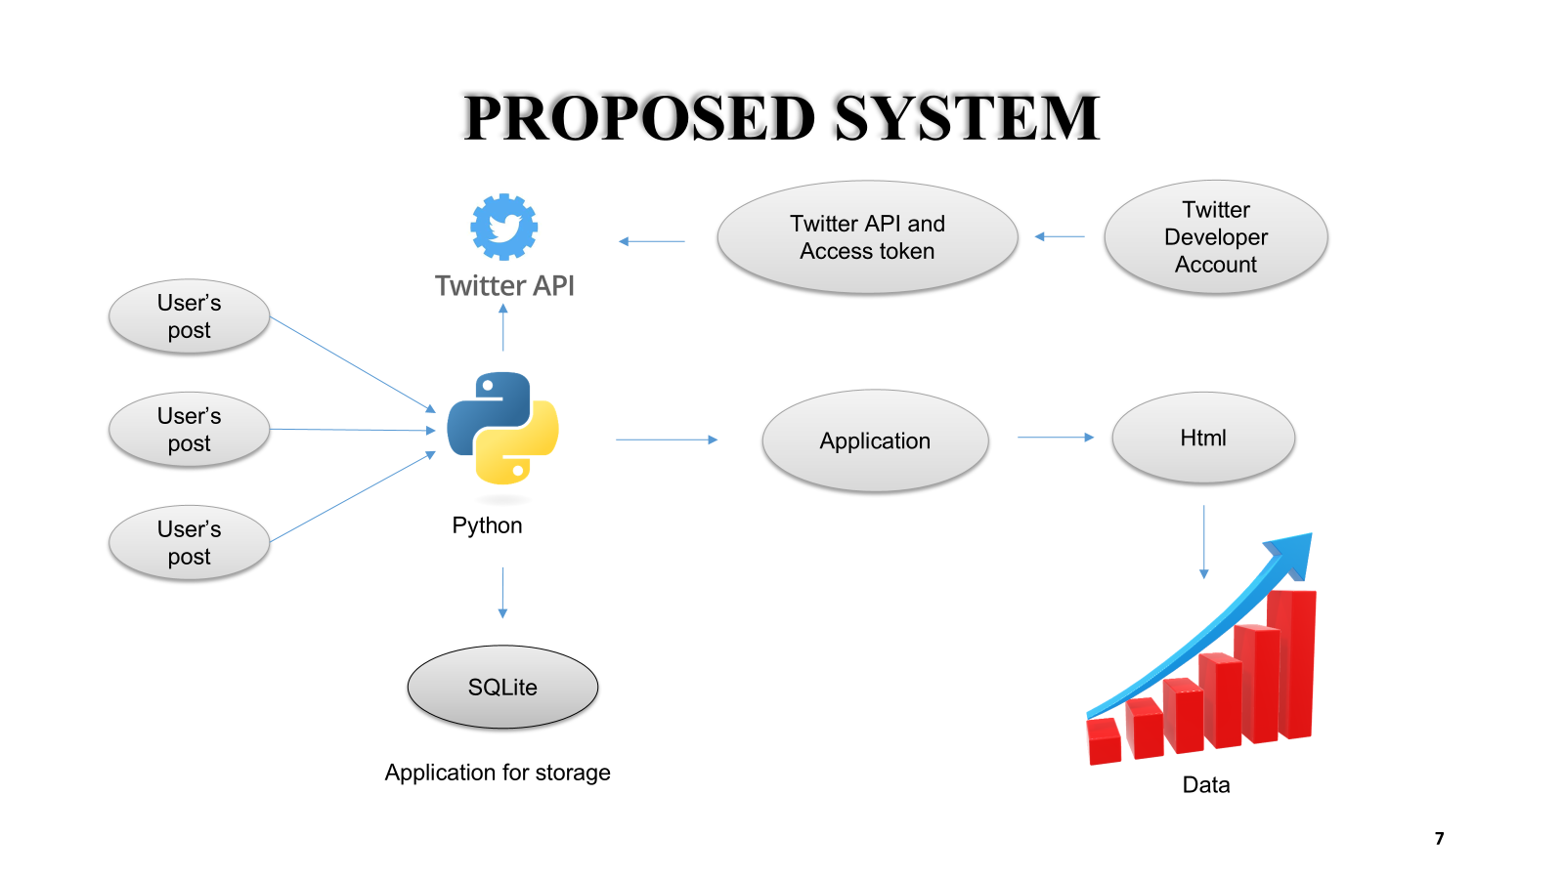



Slide 7
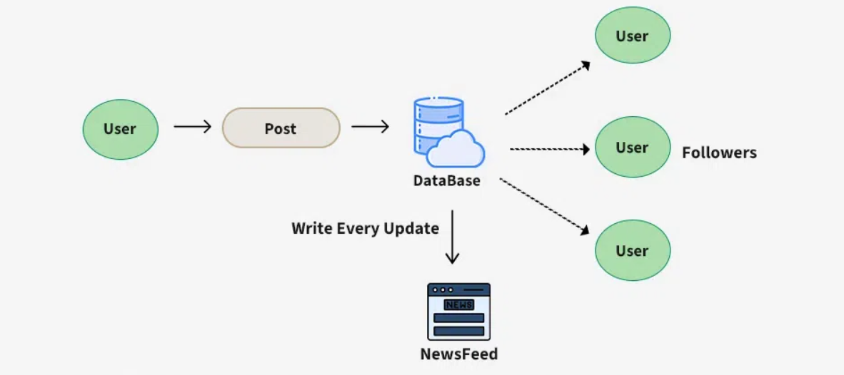
EXISTING SYSTEM ARCHITECTURE

Slide 8
SOFTWARE AND HARDWARE REQUIREMENTS
HARDWARE
SOFTWARE
CPU
Minimum: Dual-core processor (e.g., Intel i3, AMD equivalent)
Recommended: Quad-core or higher (e.g., Intel i5/i7, AMD Ryzen 5/7) for faster data processing and better multitasking.
RAM
Minimum: 4 GB
Recommended: 8 GB or more
Storage
Minimum: 20 GB of available disk space
Recommended: 100 GB or more
Operating System :
Windows 10/11 or
macOS or
Linux (Ubuntu, Debian, CentOS)
Programming language :
Python 3.7+
Twitter Developer Account :
Twitter API Access

Slide 9
MODULES
User Interface
Backend Module
Sentiment Analysis Module
Twitter API Integration Module

Slide 10
USER INTERFACE
This module will handle the user interface users can input search queries and view the sentiment analysis results of the tweets.
Accept input from the user (search term).
Make requests to the backend to fetch tweets and sentiment results
Display the output

Slide 11
BACKEND MODULE
The backend module handles the business logic of fetching tweets, processing them, and serving data to the frontend via an API.
Set up a web server to handle API requests from the frontend.
Call the Twitter API to fetch relevant tweets.
Send the analyzed data (tweets with sentiment) back to the frontend.

Slide 12
SENTIMENT ANALYSIS MODULE
This module is responsible for analyzing the sentiment of fetched tweets.
Process each tweet's text.
Perform sentiment analysis and classify the tweet as positive, neutral, or negative.

Slide 13
TWITTER API INTEGRATION
This module handles the integration with the Twitter API to fetch live tweets based on user input.
Authenticate using Twitter API credentials (API Key, Secret, Access Tokens).

Slide 14
SUMMARY OF MODULE-1
Data Collection and Sentiment Analysis
The module collects tweets using the Twitter API based on a specified location and keywords related to mental health.
It filters tweets to exclude retweets and ensures only English-language tweets are analyzed.
Classification of tweets into three categories: happy, depressed, or neutral based on polarity scores. This provides insights into the general mood of the tweets.

Slide 15
SUMMARY OF MODULE-2
Data Storage and Reusability
The backend uses an SQLite database to store tweets along with their sentiment and location data.
Previously analyzed tweets are retrieved from the database instead of making repetitive API calls, reducing latency and API usage.
This feature ensures efficient data management and improves the module’s scalability.

Slide 16
SUMMARY OF MODULE-3
Visualization and Reporting
A sentiment distribution chart is generated using Matplotlib to visually represent the count of tweets in each sentiment category.
The chart helps users quickly understand the emotional trends in tweets related to mental health for a given location.
The chart is sent to the frontend as a PNG image, providing a clean and interpretable output for end-users.

Slide 17
SUMMARY OF MODULE-4
User-Friendly Interface
A countdown timer shows the time remaining before the next request can be made due to rate limits, ensuring clarity and transparency.
The frontend seamlessly integrates with the backend, offering a smooth and responsive user experience while presenting the sentiment analysis results in a visually appealing format.

Slide 18
RESULTS AND DISCUSSION
Successfully categorized tweets into happy, depressed, and neutral sentiments using TextBlob.
Generated sentiment distribution charts for location-specific mental health trends.
TextBlob performed well for basic sentiment analysis but struggled with nuanced expressions like sarcasm.
Twitter API’s rate limits restricted analysis to recent tweets; future work could explore historical data.
Visualization was effective but could be enhanced with more detailed graphs.

Slide 19
CONCLUSION
This project demonstrates the potential of leveraging social media platforms like Twitter to analyze public sentiment on mental health across different locations.
The system provides valuable information to identify trends and patterns in mental health discussions.

Slide 20
THANK YOU

